Slide 1


Fundamentals of RM
RM System and Process
Leadership in RM
Incident Investigation
RM Tools & Challenges
RM in Industry
People & Org.
Application and Perspectives
On Becoming a
Leader in Risk Management
ENGG404 - Lecture
Case 11:
Environmental Challenges

Slide 2
Learning Outcomes:
At the end of this module, the student should be able to:
Apply critical thinking skills on a complex issue at a high level that involves the environment and the challenges we face.
Case 11: Environmental Challenges
‹#›
Notes:
‹#›

Slide 3
Pipelines – Good or Bad?
Why can’t we get any pipelines built in this country?
Historical spills and other disasters like Exxon Valdez have created strong grass-roots resistance.
Cross-jurisdictional issues –
First Nations, federal, provincial, municipal.
Public opinion and opposing views: climate change vs. responsible energy production.
But what are our other options?
Enbridge Northern Gateway Pipeline (Hardisty to Kitimat) – not approved by Canada, shelved.
TransCanada Energy East - shelved in 2017 by TransCanada (prices of oil – project not financially feasible).
TransCanada Keystone XL – rejected by Obama, reversed by Trump, approved by Trump, just received Nebraska approval.
Kinder Morgan Trans Mtn Twinning (Hardisty to Burnaby) – approval overturned by The Supreme Court; ownership acquired by GoC, now known as TMX, and recently approved (June 2019) – construction in progress but still challenged!
Enbridge Line 3 expansion (Hardisty to Wisconsin) – approved in Canada, hurdles remain in the US.
Case 11: Environmental Challenges
‹#›
Notes:
‹#›

Slide 4
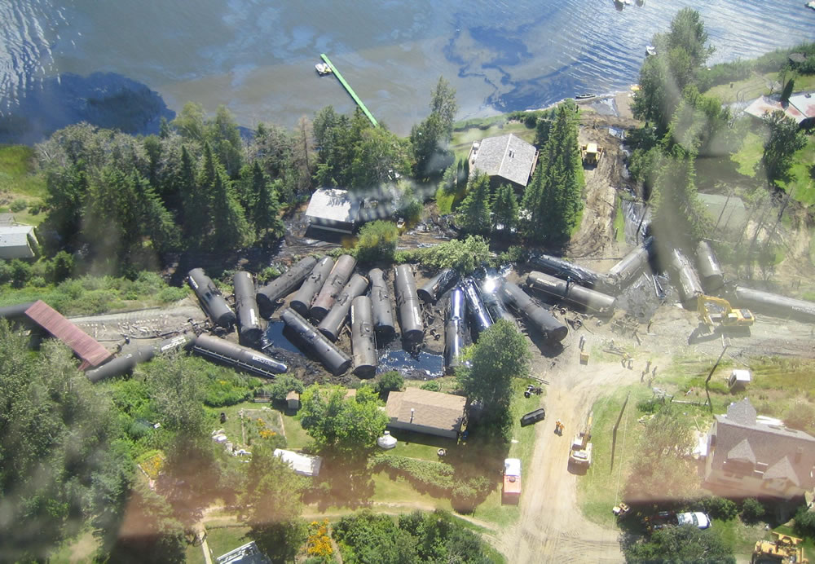
However we also have issues with rail transport of oil …
CN Rail at Lake Wabamun, Alberta August 3, 2005:
No fatalities, no injuries; indeterminate aquatic life kill
Almost 800,000 litres of heavy oils spilled into the lake
43 rail-cars, rail-bed, locomotives, several local properties, contents of the rail-cars
$140 million in costs; out of service for several days, interruptions to customers
Case 11: Environmental Challenges
‹#›
Notes:
‹#›

Slide 5
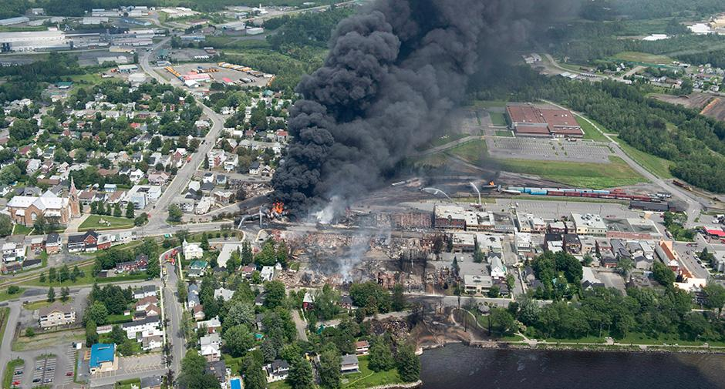
However we also have issues with rail transport of oil …
MMA Rail at Lac Megantic, Quebec – July 6, 2013
47 fatalities, 5 missing, over 2,000 evacuated
Over 8 million litres of petroleum crude oil were spilled and caught fire;
100,000 litres escaped to the near-by river; heavy smoke emitted and dispersed
Significant asset damage – train loss; centre of town destroyed
Case 11: Environmental Challenges
‹#›
Notes:
‹#›

Slide 6
Issues Associated with Modern, Industrial Human Activity:
Pipeline versus railcar: oil transportation risks for sub-surface continuous vs over-land periodic.
Impacts on PEAP resulting from initial construction.
Impact on PEAP resulting from incidents during operation.
Environmental impacts:
      Risk of leaks and spills to land & in-land waters, and the ability to detect and measure quantity released?
      Disruption of natural habitat – one-time vs on-going.
      Environmental impacts and energy consumption:
      Hydrocarbons consumption and CO2/GHG emissions due to production, transportation, and consumption
Worker safety?
Case 11: Environmental Challenges
‹#›
Notes:
‹#›

Slide 7
Issues Associated with Modern, Industrial Human Activity:
Compare RC vs PL Performance:
Transport Safety:
In terms of million barrels of oil equivalents transported (MBOE), rail transport experiences 4.5 times more occurrences than pipelines.
Environmental impacts:
73% of pipeline occurrences result in spill of <1m3, with no release in 16% of occurrences.
83% and 85% of pipeline and railcar occurrences, respectively, happen at facilities and not during transit. Secondary containment is often present at those facilities.
Energy consumption:
In long distance transportation, pipelines produce 61%-77% less GHG emissions than rail transport.
Worker Safety:
Rail transport results in almost 2 times more serious injuries per ton-mile than pipelines in the US.
Case 11: Environmental Challenges
‹#›
Notes:
‹#›

Slide 8
Example: Metrics on Spill “Performance”:
Baseline Metric to Compare RC vs PL Performance:
There are several different ways of transporting hydrocarbon products (crude or semi-processed, or finished oil products e.g. diesel fuel) such as pipeline and rail-car as a comparison here (Others: highway transport truck, super-tanker, barges, physical barrels, etc.)
One key metric that can be measured is the “number of barrels of product released to the environment”.
In order to compare the different modes, (much like base-line calculation for the Lost-time Injury Rate), the performance metric can be based on the “number of barrels transported” and the “number of kilometers transported” in a “year”.
For example:
“barrels released per million barrel-kilometers transported per year”
Case 11: Environmental Challenges
‹#›
Notes:
‹#›

Slide 9
Issues Associated with Modern, Industrial Human Activities:
Although there are many challenges, one key challenge will be the evaluation and selection of one of many alternative technologies to reduce our impact on the environment.
Most notable choices are the alternative technologies to limit our human impact on 1.5Cdeg global temperature rise.
Thus, our efforts opposite this challenge must look at the broader impacts:
      Not focused on one or a narrow set of activities or one.
Consider - Upstream impacts? Downstream impacts?
      What are these?
      Need to critically think and analyze these!
Only through this process will we:
Have “all the data”,
Be able to make quantitative assessments of all alternatives,
Make “apples to apples” comparisons of those assessments based on our best available data, and best available assessment methodologies, and finally
Make an informed decision, the choice that has the least negative impact on the environment i.e. limit our human impact to <1.5Cdeg.
Case 11: Environmental Challenges
‹#›
Notes:
‹#›

Slide 10
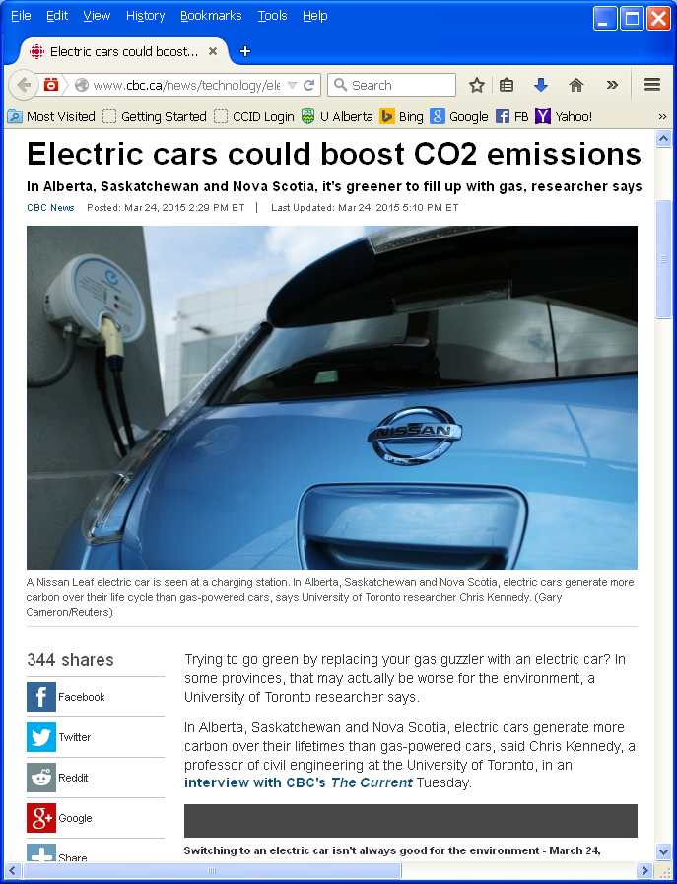
Are “Green Solutions” Really the Answer?
CBC News Article:
“Electric cars could boost CO2 emissions in some provinces:
Trying to go green by replacing your gas guzzler with an electric car? In some provinces, that may actually be worse for the environment, a University of Toronto researcher says.”
http://www.cbc.ca/news/technology/electric-cars-could-boost-co2-emissions-in-some-provinces-1.3007409; Accessed 20150324
Case 11: Environmental Challenges
‹#›
Notes:
‹#›

Slide 11
Are “Green Solutions” Really the Answer?
Being “not sure” is not a bad thing!
Critical thinking: “The objective analysis and evaluation of the facts of an issue (an issue may have two or more opinions but only one set of facts) in order to form a judgement.”
“… a person strongly disposed toward critical thinking has a desire to follow reason and evidence wherever they may lead”
Such a person may hold two or more opinions on an issue during this period.
Ref: https://en.wikipedia.org/wiki/Critical_thinking
https://en.oxforddictionaries.com/definition/critical_thinking
Case 11: Environmental Challenges
‹#›
Notes:
‹#›

Slide 12
Application of a Qualitative Tool to Compare Alternative Technologies:
Electrically Powered Motor Vehicle
Upstream:
Neg: mining for exotic metals for batteries, motors, wiring
Neg: requires new power generation capacity
Pos: renewable electrical energy source if hydro or solar or wind
Neg: non-renewable electrical energy source if coal or oil or natural gas
Neg or Pos: nuclear power stations?
Downstream:
Pos: no exhaust emissions
Neg: requires new infrastructure for recharging stations
Neg: disposal of spent / toxic metals
Neg. increases consumption of electricity
Pos: mature recycling industry will readily adapt to capturing value of exotic metals
Internal Combustion Gasoline Engine Vehicle
Upstream:
Pos: renewable bio-sources, ethanol
Neg: non-renewable fossil fuels
Downstream:
Neg: emissions from engines
Pos: existing fuel production & distribution network
Neg: consumes non-renewable resource
Pos: mature recycling industry
Case 11: Environmental Challenges
‹#›
Notes:
‹#›

Slide 13
Summary and Key Lessons:
So, you are now somewhat more skilled to compare the “green-ness” of a variety of technical alternatives e.g. the transportation of oil by Pipeline or by Tanker Railcar
Identify the positive and negative impacts on the environment.
Consider:
  Upstream side: during construction? during operation?
  Downstream side: energy consumption to deliver one barrel of oil? potential quantity of oil leak or spill?
This is a simplistic approach and cannot be definitive in its conclusion;
to be conclusive, quantitative data must be compared.
This approach is intended to generate the questions that NEED to be answered with quantitative data.
Transportation of Oil via Pipeline
Upstream:
Downstream:
Transportation of Oil via Tanker Rail-car
Upstream:
Downstream:
Case 11: Environmental Challenges
‹#›
Notes:
‹#›

Slide 14
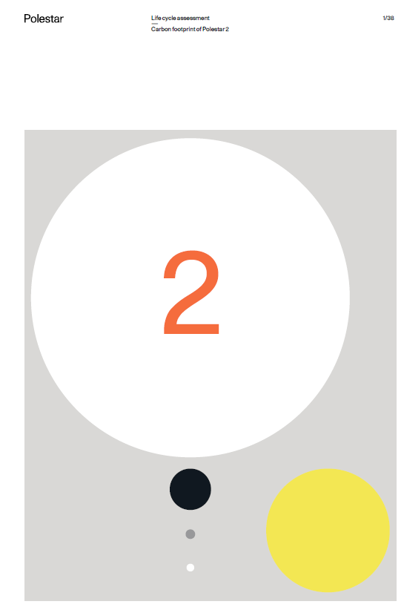
Volvo Polestar 2 Report:
Lifecycle Assessment “Carbon Footprint of Polestar 2”
Analysis of Polestar 2 (model year 2020)
and Volvo XC40 gasoline internal
combustion engine (model year 2020)
The carbon footprint presented in this
report is based on a Life Cycle Assessment
(LCA), performed in this study according
to ISO LCA standards
Polestar 2 Lifecycle Assessment Report; Lisa Bolin, LCA Specialist; Fredrika Klarén,
Quality and Sustainability; published15-September-2020 https://www.polestar.com/dato-assets/11286/1600176185-20200915polestarlcafinala.pdf ; accessed 15-July-2021
Case 11: Environmental Challenges
‹#›
Notes:
‹#›

Slide 15
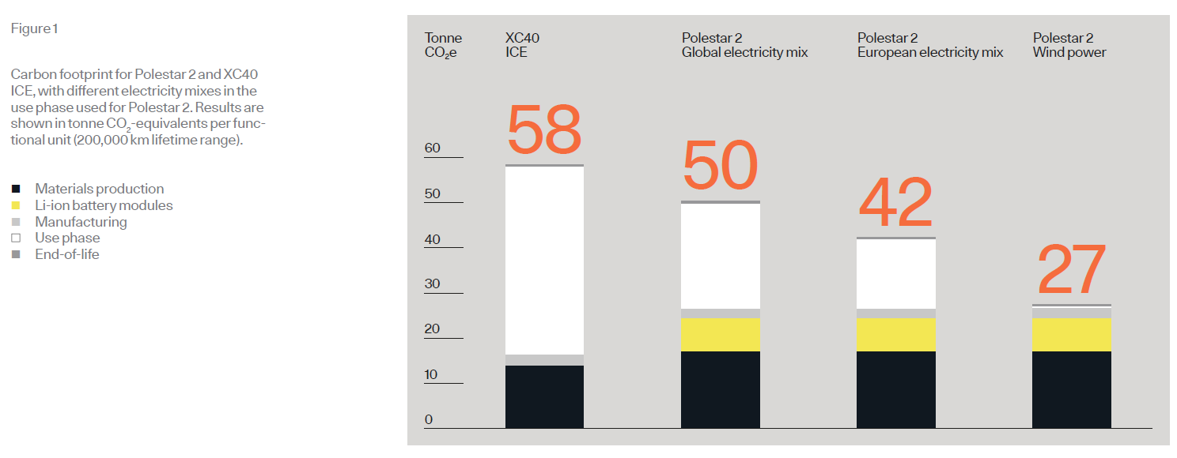
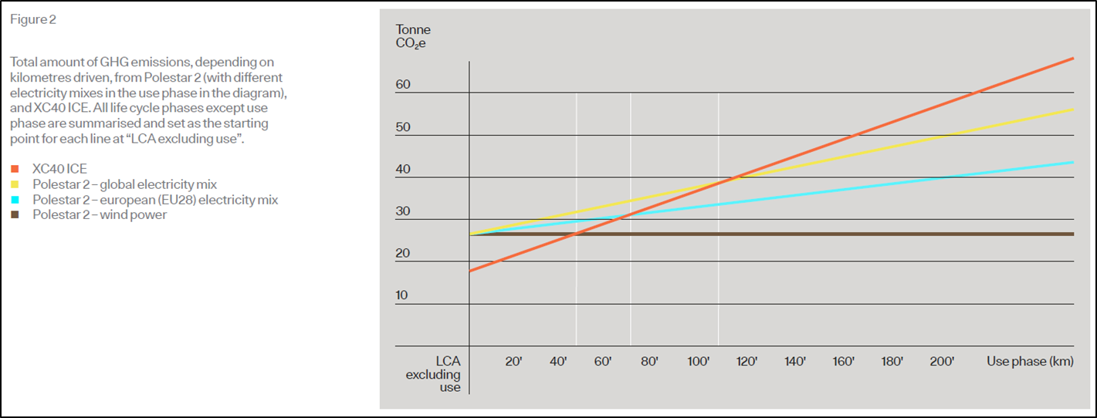
Volvo Polestar 2 Report:
Lifecycle Assessment “Carbon Footprint of Polestar 2”
Many assumptions:
“The two main differences in the carbon footprint between the Polestar 2 and the ICE appear in the materials production (including the Li-ion battery modules) and the use phase.”
“It should be noted that the carbon footprint was performed to represent a globally sourced version of the car models. Other methodological choices that have a large impact on the result are choice of allocation method regarding scrap, and choice of datasets for steel and aluminium production.”
Case 11: Environmental Challenges
‹#›
Notes:
‹#›

Slide 16
Summary and Key Lessons:
Solutions are not as simple as they may seem!
Getting answers can be an extremely complex study.
To accept and resolve challenges, critical thinking is a essential.
As a professional engineer, YOU WILL NEED TO:
Judge the evidence (i.e. apply critical thinking) in order to make informed decisions in light of:
  Growing complexity and magnitude of information;
  Diverse and differing expert opinions;
Provide clarity and “plain language” in the explanations of scientific and engineering concepts:
  Applies to your team and decision-makers, as well as the public
  People sometimes make decisions based on emotion, not only facts!
Make decisions (or advocate for those decisions) based on validated data and evidence:
  Do your homework!
  Use good, validated data in risk analyses.
  Be very careful where you get your data from!
… because it is our professional duty.
Case 11: Environmental Challenges
‹#›
Notes:
‹#›

